Slide 1


Deep Space Communication utilizing IP Stack and Reinforcement Learning Algorithms
Sivakrishna Manoj
Dept. of ECE, SRM Institute of Science and Technology
WiSPNET, 22nd March 2025

Slide 2
Introduction & Motivation
Adopting an IP-centric approach leverages standardized and scalable internet protocols (e.g., IPv6) that are already proven on Earth to improve deep-space communications.
Existing RF methods face challenges such as high latency and limited interoperability, which are increasingly problematic for interplanetary links.
Incorporating reinforcement learning into delay-tolerant networking (DTN) enables dynamic, optimal routing decisions in environments with long delays and variable conditions.
Our aim is a future-proof deep-space communication framework.

Slide 3
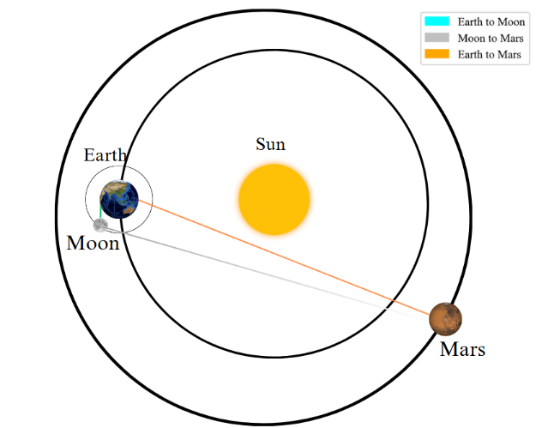
Research Methodology
Ka-Band Parabolic Reflector Antenna implemented with MATLAB's Antenna Designer toolbox. (See Table I)
Link Case Studies (Fig. 2):
Case A: Earth-Moon direct link.
Case B: Earth-Mars direct link.
Case C: Moon-Mars direct link.
Emphasis on direct satellite-to-satellite communication.
Performance Analysis:
Theoretical link budget analysis is validated via monte carlo simulations. SCPS/IPv6 is used to demonstrate parsing of a small test message. Comparative analysis is performed for SCPS-TP and RL-DTN implementation.
Antenna Type | Parabolic Reflector
Frequency | 32 to 34.2 GHz
Diameter | 1.5 m
Focal Length | 0.7 m
f/d ratio | 0.467 m
Exciter | Conical horn
Aperture radius of the exciter | 0.102 m
Table I: Antenna Specifications
Fig. 2: Interplanetary Links

Slide 4
Research Methodology
The link budget analysis provides vital information on how much power the system will require.
Table II present the theoretical link budget analysis carried out based on the data from the antenna [6, 11].
The received power is well within the acceptable threshold for all the three cases.
Parameters | Earth to Moon |  | Earth to Mars |  | Moon to Mars
 | Up-Link | Down-Link | Up-Link | Down-Link | Up-Link | Down-Link
Distance (m) | 3.84× 10⁸ | 3.84× 10⁸ | 4.00× 10¹¹ | 4.00× 10¹¹ | 4.014× 10¹⁰ | 4.014× 10¹⁰
Frequency (GHz) | 34.2 | 32 | 34.2 | 32 | 34.2 | 32
FSPL (dB) | 234.81 | 234.23 | 277.43 | 294.59 | 275.20 | 274.59
Data Rate (Mbps) | 4.5 | 4.5 | 3 | 3 | 4.5 | 4.5
Transmitter Power (dBm) | 73 | 50 | 73 | 50 | 50 | 60
Transmitter Gain (dBi) | 47 | 46.7 | 47 | 46.7 | 47 | 46.7
Receiver Gain (dBi) | 47 | 47.6 | 47 | 47.6 | 47 | 47.6
Losses (dB) | 4 | 4 | 2 | 2.71 | 4 | 4
Receiver Power (dBm) | -79.21 | -101.33 | -112.43 | -153.19 | -135.20 | -124.89
Table II: Link Budget Parameters

Slide 5
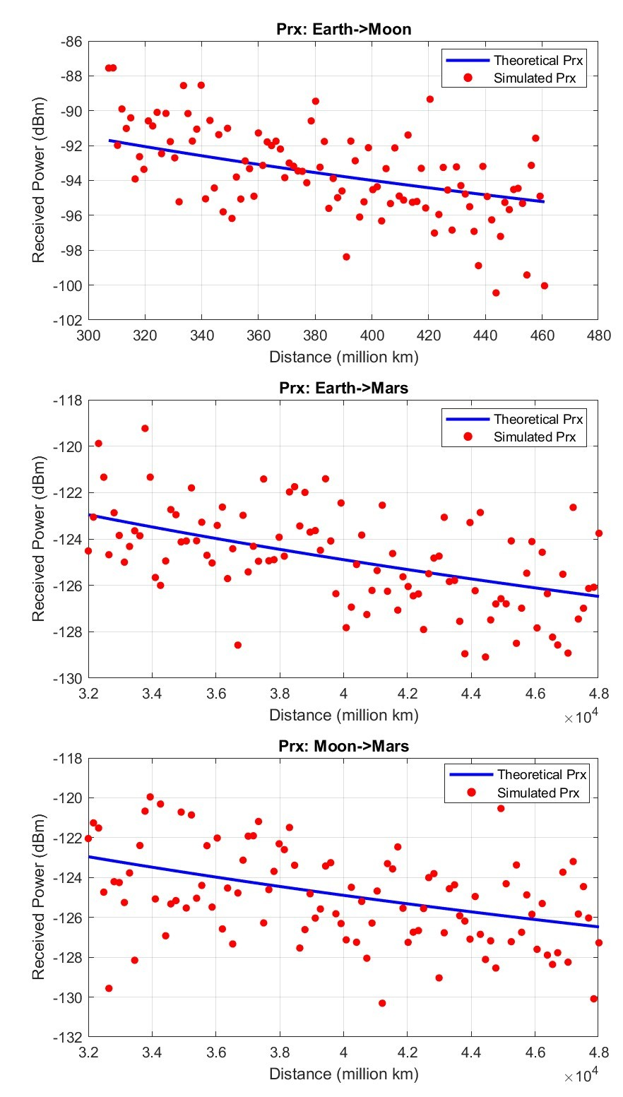
Results & Discussion
Monte Carlo Simulation models randomness in signal propagation.
Introduces variations in signal attenuation, noise and path loss.
Validates theoretical link budget through multiple trials.
Simulated values closely follow the theoretical curve, showing high correlation.
Case A: stable & predictable link, minimal variations.
Case B & C: Greater signal fluctuations due to the greater distance.
Fig. 3: Monte Carlo Scatter plot

Slide 6
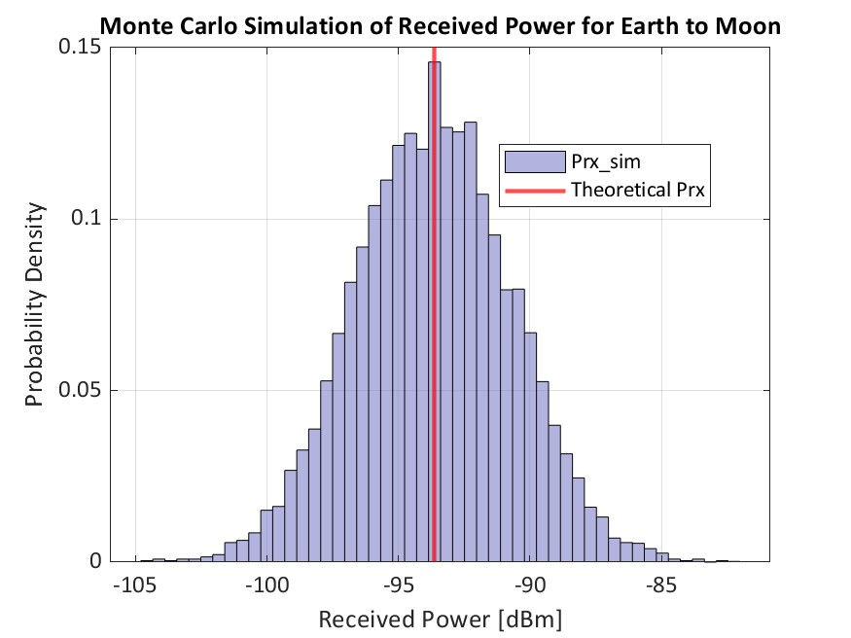
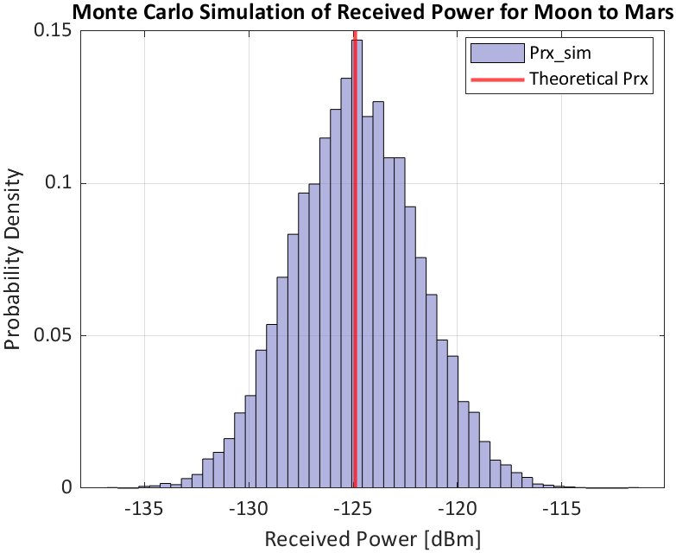
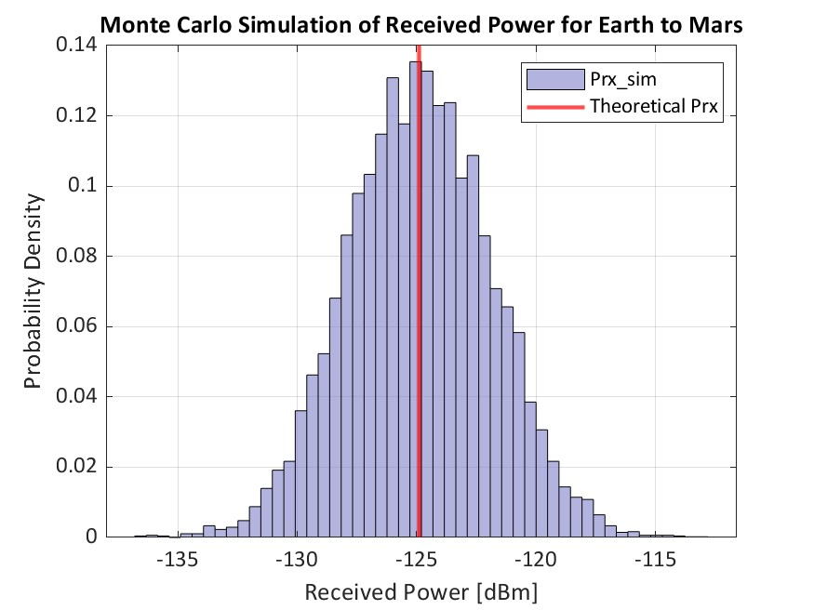
Results & Discussion
Histogram representations in Fig. 4 are used to illustrate the distribution of received power values.
Theoretical curve aligns well with the peak of the histogram, confirming the accuracy of the link budget model.
Case A: Highly stable with minimal variations.
Case B: Received power ranges from -140dBm to -115 dBm.
Case C: Power varies between -135 dBm to -115 dBm.
Theoretical and simulated results are within acceptable thresholds.
Fig. 4: Monte Carlo Histogram

Slide 7
SCPS/IPv6 Implementation
SCPS (9-byte) encapsulated in IPv6 (40-byte)
Successfully builds, parses and recovers “Hello from deep space! This is a test message...”
Packet Overhead Analysis (Table III):
  16-byte payload (for example):
  SCPS: 25 bytes (36.0% overhead)
  IPv6: 65 bytes (61.5% overhead)
Larger payloads reduce overhead, improving efficiency.
SCPS/IPv6 is robust and optimized for deep space links.
Payload (Bytes) | SCPS Packet (Bytes) | IPv6 Packet (Bytes) | SCPS overhead (%) | IPv6 overhead (%)
16 | 25 | 65 | 36.0 | 61.5
64 | 73 | 113 | 12.3 | 35.4
256 | 256 | 305 | 3.4 | 13.1
1024 | 1033 | 1073 | 0.9 | 3.7
4069 | 4106 | 4145 | 0.2 | 1.0
Table III: SCPS/IPv6 overhead results

Slide 8
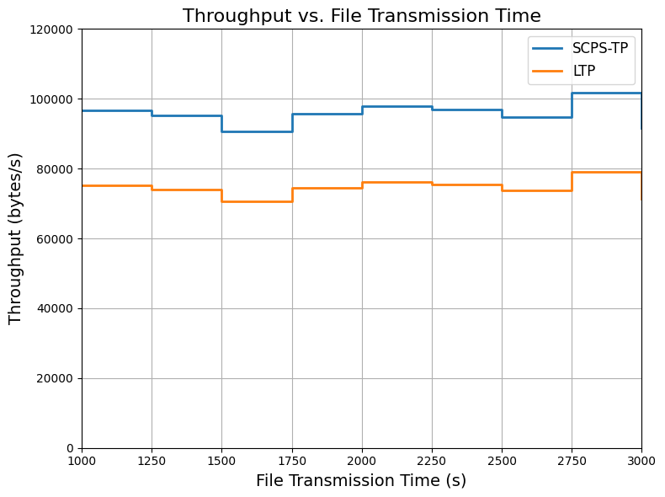
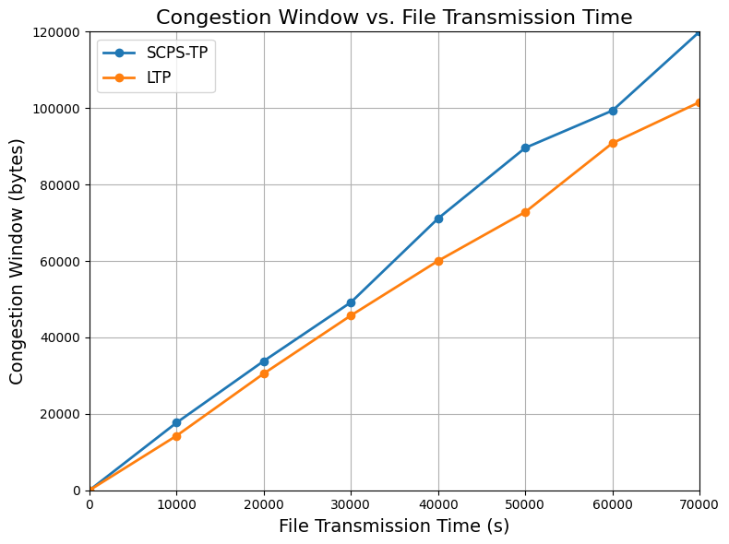
SCPS-TP vs LTP Performance
Throughput Comparison (Fig. 5):
SCPS-TP: 90,000-100,000 bytes/s, while LTP: 80,000 bytes/s. SCPS-TP more efficient for high-latency deep-space links.
Congestion Window Growth (Fig. 6):
SCPS-TP: 120,000 bytes at 70,000s while LTP: 100,000 bytes (20% smaller window). SCPS-TP utilizes available bandwidth more effectively.
Fig. 5: Throughput vs File Transmission Time
Fig. 6: Congestion Window vs File Transmission Time

Slide 9
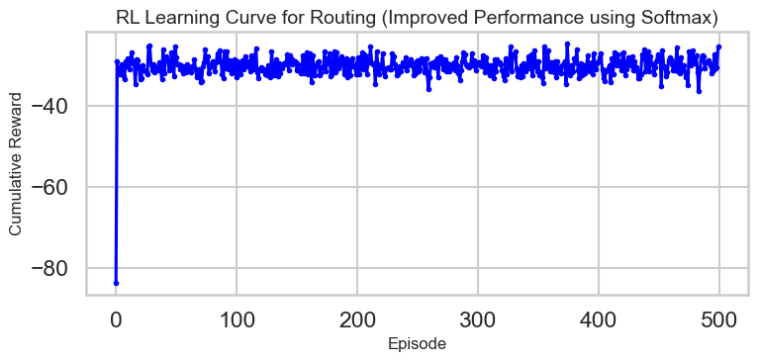
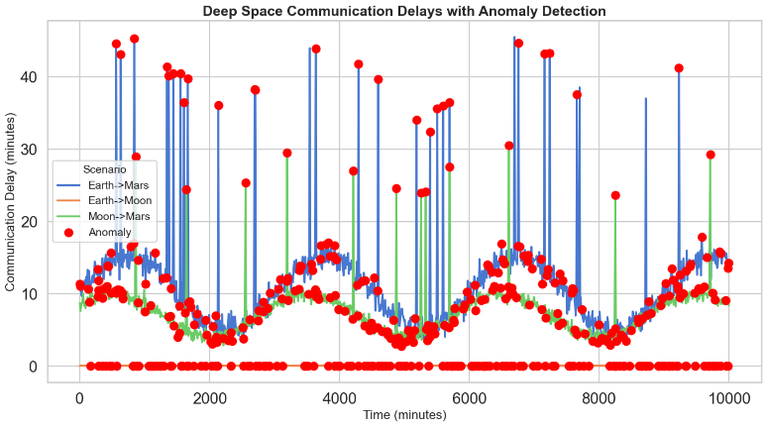
Reinforcement Learning & Anomaly Detection
Reinforcement Learning for DTN:
Modelled in Python, optimizes routing using a reward-penalty system.
Optimal paths earn rewards; suboptimal paths incur penalties.
Early training: Inefficient route, highly negative reward.
Later episodes: Stabilized rewards.
Anomaly Detection with Isolation Forest:
Detects outliers in communication delays.
Identifies unusual spikes/dips in all 3 links.
Fig. 7: Learning curve of RL based DTN
Fig. 8: Anomaly Detection in Communication delays

Slide 10
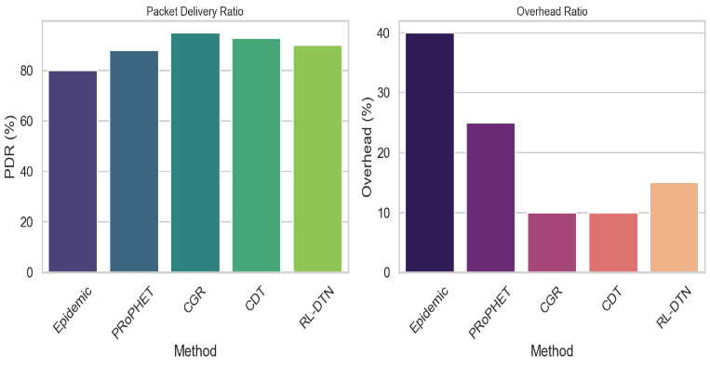
Comparison of DTN protocols
Packet Delivery Ratio (PDR) & Overhead Ratio Analysis:
CGR: Contact graph routing Maximum PDR, negligible overhead because of deterministic contact scheduling.
CDT: Nearly optimal delivery at low overhead, needs ample training data.
Epidemic: Minimum PDR, maximum overhead because of inefficient flooding.
PRoPHET: Better than Epidemic but still has considerable overhead.
RL-DTN: Balanced performance, better than Epidemic & PRoPHET in both areas.
RL-DTN is efficient without rigid scheduling (CGR) or vast labelled data (CDT).
Fig. 9: Comparison of RL-DTN against existing models

Slide 11
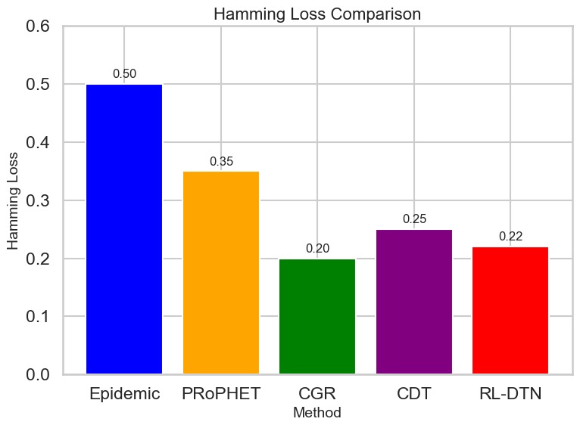
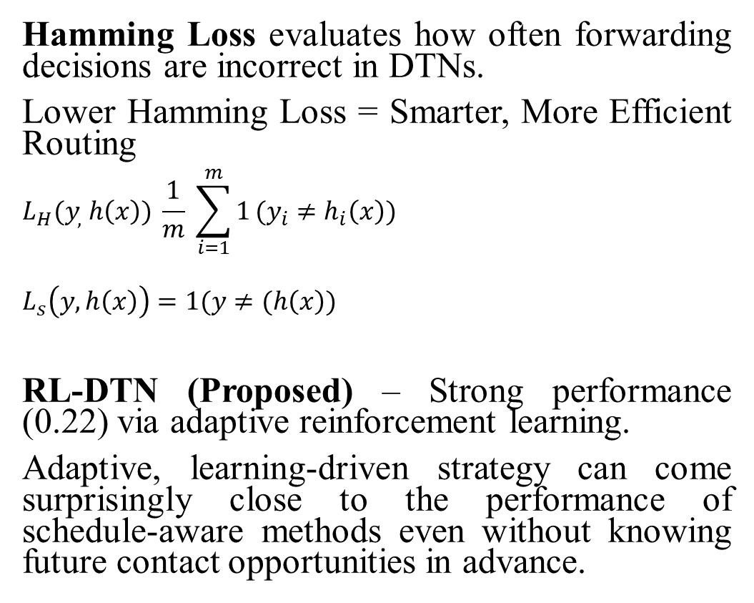
Comparison of DTN protocols
Hamming Loss evaluates how often forwarding decisions are incorrect in DTNs.
Lower Hamming Loss = Smarter, More Efficient Routing
$$L_{H}(y_{,} h\left(x\right)) \frac{1}{m} \sum_{i=1}^{m}{1}(y_{i}≠h_{i}\left(x\right))$$
$$L_{s}\left(y, h\left(x\right)\right)=1(y≠(h\left(x\right))$$
RL-DTN (Proposed) – Strong performance (0.22) via adaptive reinforcement learning.
Adaptive, learning-driven strategy can come surprisingly close to the performance of schedule-aware methods even without knowing future contact opportunities in advance.
Fig. 9: Comparison of RL-DTN against existing models

Slide 12
Conclusion and Future work
This paper presents a comprehensive analysis of a Ka-Band and IP Stack based communication system which utilizes reinforcement learning and isolation forest algorithms for optimal routing and anomaly detection. The Monte Carlo simulations carried out on MATLAB prove the high gain antenna to be a suitable system. The RL model is proven to be able to train itself to find the most optimal routes. The isolation forest algorithm is successfully able to isolate and detection anomalies in the synthetic dataset. IPv6 and SCPS TP protocols were successfully demonstrated with SCPS-TP performing better than LTP in deep space conditions and RL-DTN is shown to be a balance between existing DTN protocols.

Slide 13
References
[1] M. Blanchet and Viagénie, “Beyond Earth: Exploring the Future of Deep Space Communications”, IEEE CTN, May 2024
[2] M. Blanchet, C. Huitema, and D. Bogdanovic, “Revisiting the Use of the IP Protocol Stack in Deep Space: Assessment and Possible Solutions,”Ietf.org,Sep.10,2024. https://www.ietf.org/archive/id/draft-many-deepspace-ip-assessment-02.html (accessed Mar. 07, 2025).
[3] M. Adalier, et al., “Efficient and Secure Autonomous Communications for Deep Space Missions.” 2020 IEEE Aerospace Conference. IEEE, August 2020, pp. 1-15, doi: 10.1109/AERO47225.2020.9172776.
[4] W. Jiang, Y. Zhan, X. Xiao and G. Sha, “Network Simulators for Satellite-Terrestrial Integrated Networks: A Survey.” IEEE, IEEE Access vol. 11, pp. 98269-98292, September 2023, doi: 10.1109/ACCESS.2023.3313229
[5] I. Mehdi, J. Siles, C. Chen and J. Jornet, “THz technology for space communications.” 2018 Asia-Pacific Microwave Conference (APMC). IEEE, November 2018.
[6] S. Manoj, P. Mushahary and R. R. T, "Ka-Band Transmission Link Analysis for Earth-Mars Satellite Communications," 2024 First International Conference on Innovations in Communications, Electrical and Computer Engineering (ICICEC), Davangere, India, 2024, pp. 1-5, doi: 10.1109/ICICEC62498.2024.10808668.
[7] A. Guidotti, A. Vanelli-Coralli, A. Mengali, and S. Cioni, “Non-Terrestrial Networks: Link Budget Analysis,” ICC 2020 - 2020 IEEE International Conference on Communications (ICC), Jun. 2020, doi: https://doi.org/10.1109/icc40277.2020.9149179.
[8] N. Kanth, R. Matthew and R. Mallik, “Wireless quantum key distribution at terahertz frequencies: Opportunities and challenges.” IET Quantum Communication 2024, vol. 4, pp. 450-461 January 2024, doi: https://doi.org/10.1049/qtc2.12085.
[9] J.-G. Ren et al., “Ground-to-satellite quantum teleportation,” Nature, vol. 549, no. 7670, pp. 70–73, Aug. 2017, doi: https://doi.org/10.1038/nature23675.
[10] Baker, Cameron, Kholidy and A. Hisham, “Cyber Security Advantages of Optical Communications in SATCOM Networks.” SUNY Polytechnic Institute, December 2020
[11] N. Virushabadoss, N. Mahjabeen, H. Singh, and R. Henderson, “Design of X-and Ka-Band Reflectarray Antennas for Intercelestial Communication Using CubeSat Relay,” 2021 IEEE Space Hardware and Radio Conference (SHaRC), pp. 31–34, Jan. 2021, doi: https://doi.org/10.1109/SHaRC51853.2021.9375885.
[12] G. Amendola, et al., “Low-Earth Orbit User Segment in the Ku and Ka-Band: An Overview of Antennas and RF Front-End Technologies,” IEEE Microwave Magazine, vol. 24, no.2, pp. 32-48, February 2023, doi: 10.1109/MMM.2022.3217961.
[13] R. Dudukovich and C. Papachristou, “Delay tolerant network routing as a machine learning classification problem.” 2018 NASA/ESA Conference on Adaptive Hardware and Systems (AHS). IEEE, pp. 96-103, November 2018, doi: https://doi.org/10.1109/ahs.2018.8541460.
[14] R. Wang, and S. Horan. "Protocol testing of SCPS-TP over NASA's ACTS asymmetric links." IEEE Transactions on Aerospace and Electronic Systems vol 45, no, pp. 790-798, April 2009, doi: 10.1109/TAES.2009.5089562.
[15] R. S. Sutton, “Reinforcement Learning: An Introduction: An Introduction”. Cambridge, Massachusetts: The Mit Press, 2018.

Slide 14
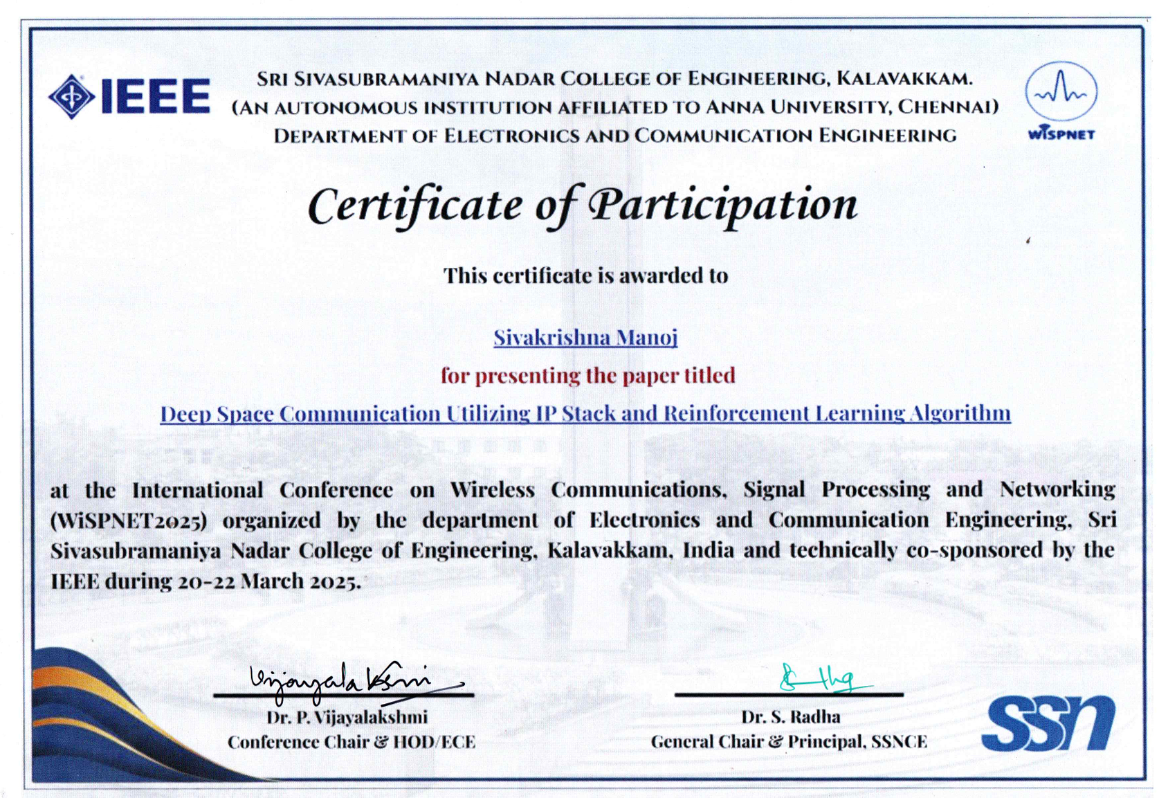
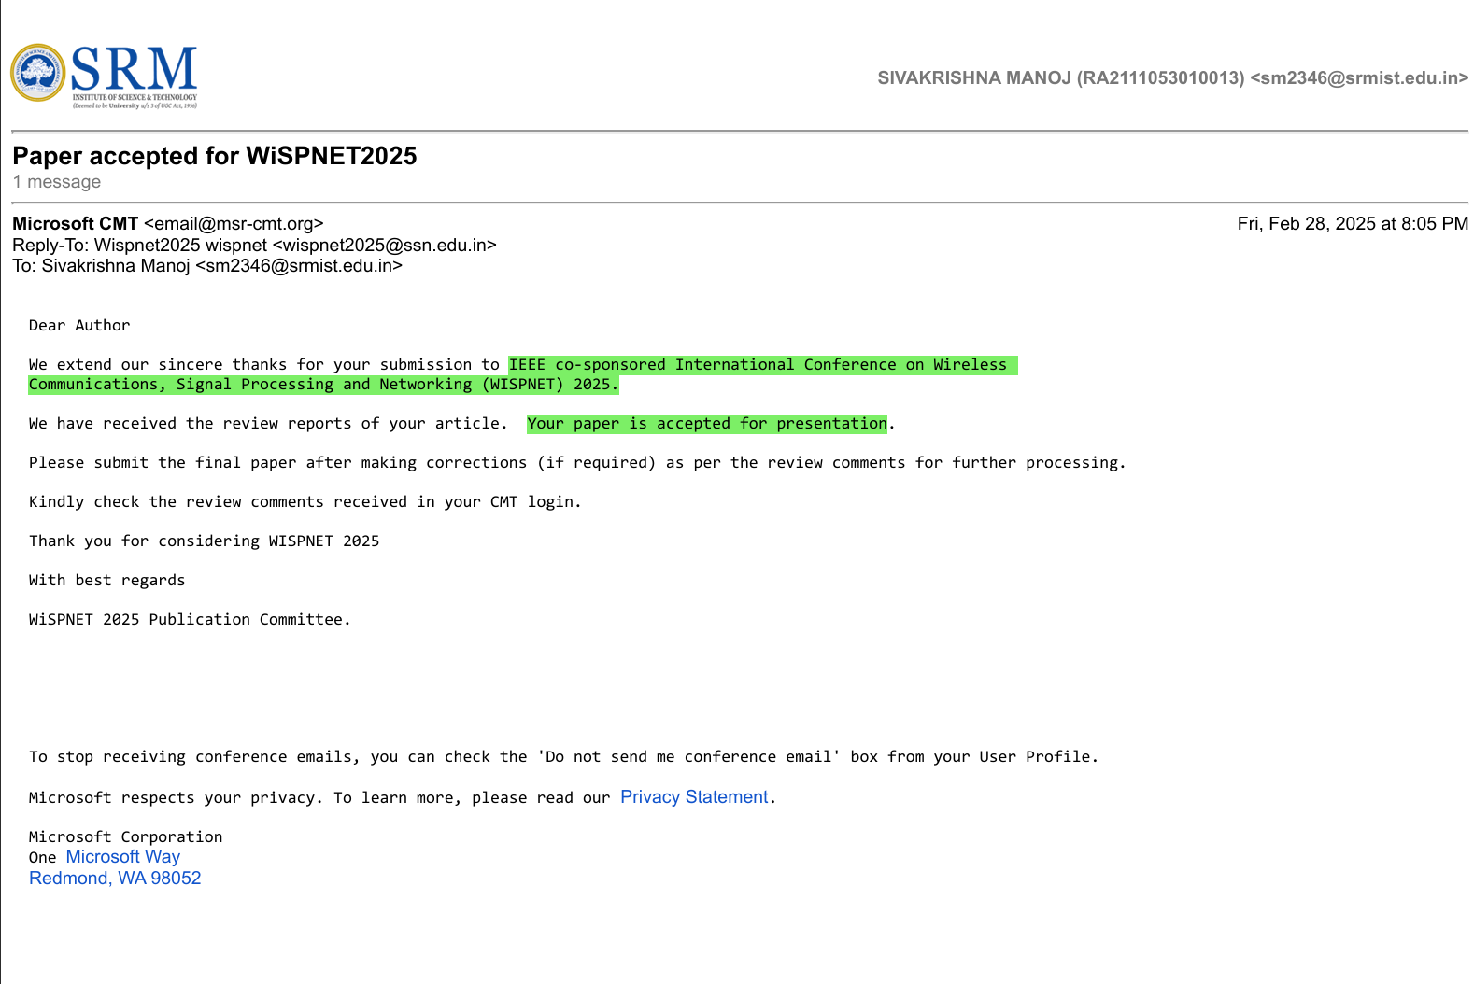
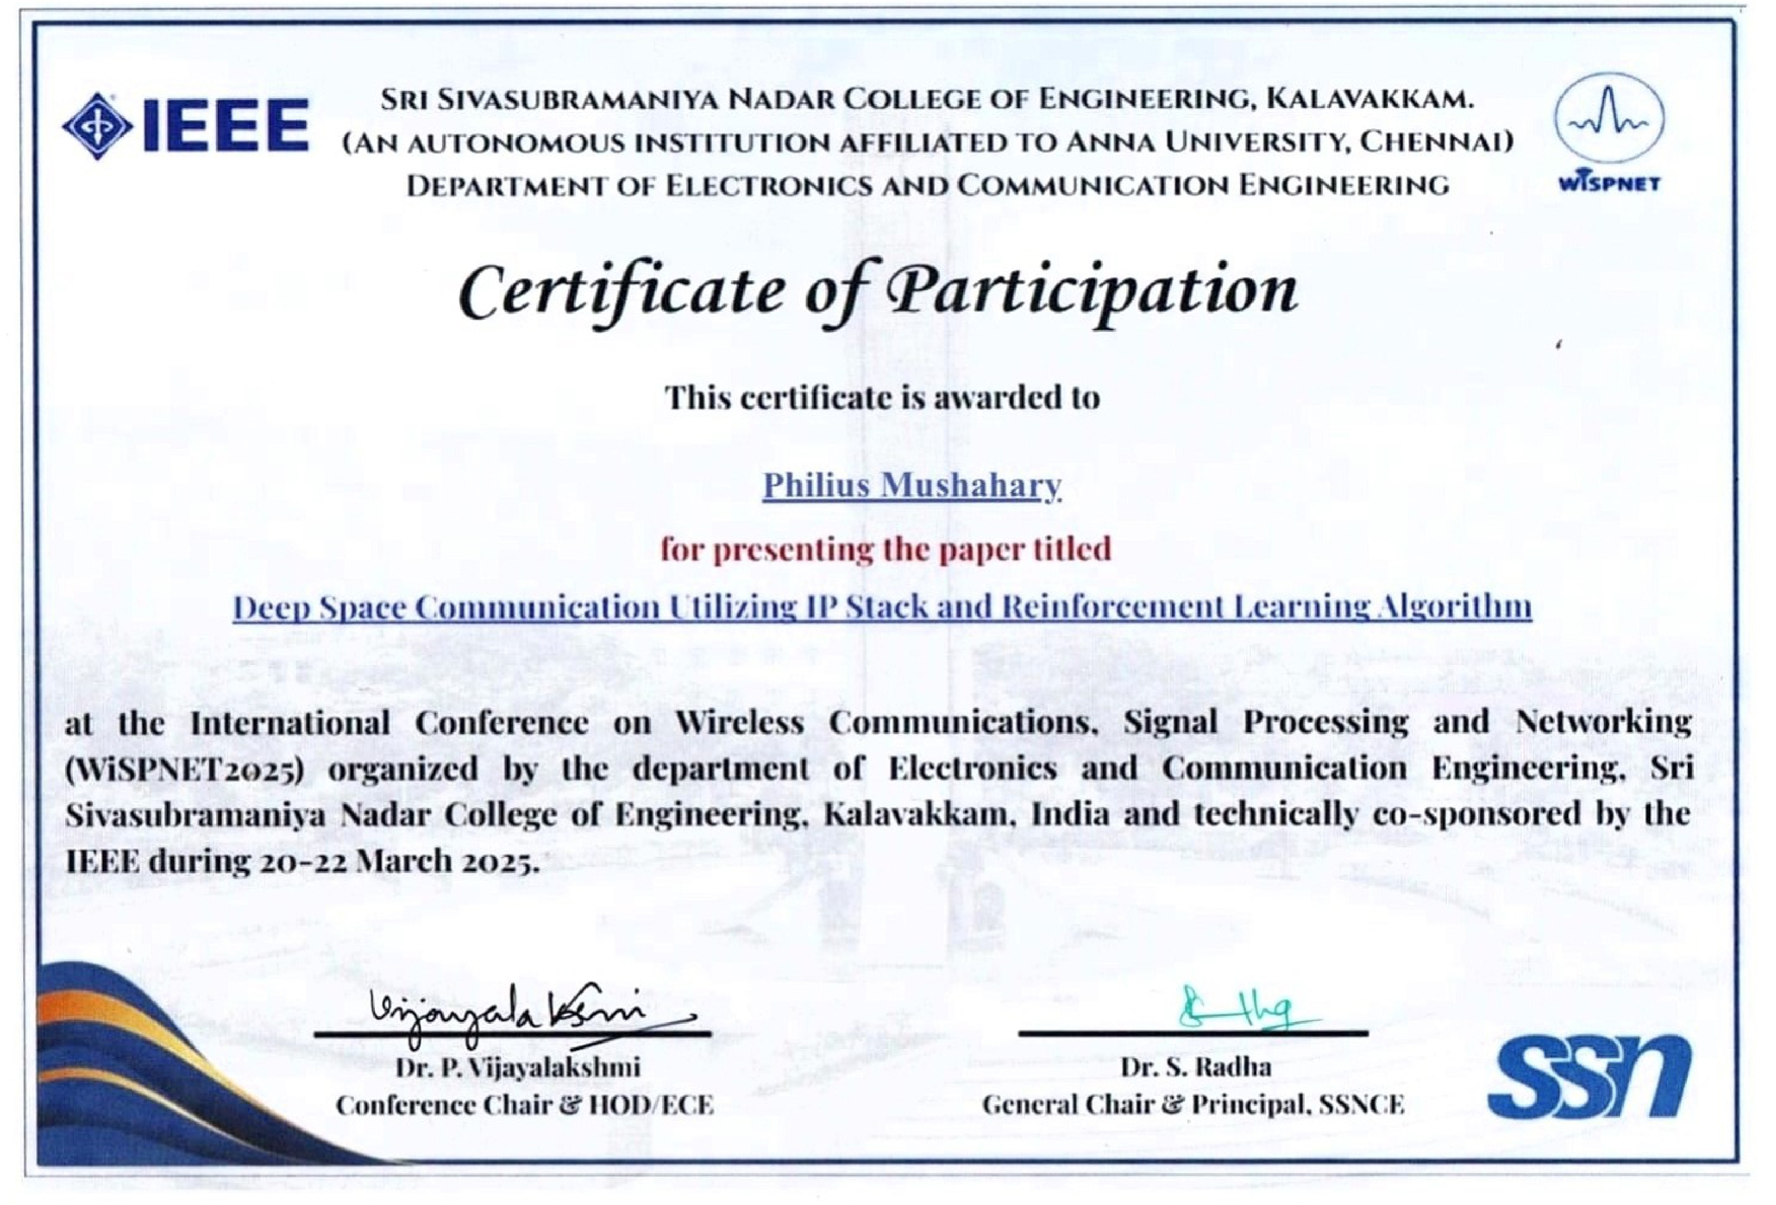
Publication Details
Our paper entitled ‘Deep Space Communication utilizing IP Stack and Reinforcement Learning Algorithm’ was presented at IEEE co-sponsored International Conference on Wireless Communications, Signal Processing and Networking (WISPNET) 2025 on 22nd March 2025.

Slide 15


